Slide 1

OPERATING SYSTEMS
CPU Scheduling
Venkatesh Prasad
Department of Computer Science

Slide 2

OPERATING SYSTEMS
Slides Credits for all PPTs of this course
The slides/diagrams in this course are an adaptation, combination, and enhancement of material from the following resources and persons:
Slides of Operating System Concepts, Abraham Silberschatz, Peter Baer Galvin, Greg Gagne - 9th edition 2013 and some slides from 10th edition 2018
Some conceptual text and diagram from Operating Systems - Internals and Design Principles, William Stallings, 9th edition 2018
Some presentation transcripts from A. Frank – P. Weisberg
Some conceptual text from Operating Systems: Three Easy Pieces, Remzi Arpaci-Dusseau, Andrea Arpaci Dusseau

Slide 3
Operating systems
Process Scheduling
Venkatesh Prasad
Department of Computer Science

Slide 4
OPERATING SYSTEMS
Basic Concepts
In a system with a single CPU core, only one process can run at a time. Others must wait until the CPU is free and can be rescheduled.
The objective of multiprogramming is to have some process running at all times, to maximize CPU utilization.
Several processes are kept in memory at one time.
When one process has to wait, the operating system takes the CPU away from that process and gives the CPU to another process. This pattern continues.
Every time one process has to wait, another process can take over use of the CPU. On a multicore system, this concept of keeping the CPU busy is extended to all processing cores on the system.

Slide 5
OPERATING SYSTEMS
Basic Concepts (Contd)
The idea is relatively simple. A process is executed until it must wait, typically for the completion of some I/O request.
In a simple computer system, the CPU then just sits idle. All this waiting time is wasted; no useful work is accomplished. With multiprogramming, we try to use this time productively.
Scheduling of this kind is a fundamental operating-system function.
Almost all computer resources are scheduled before use. The CPU is, of course, one of the primary computer resources. Thus, its scheduling is central to operating-system design.

Slide 6
OPERATING SYSTEMS
Alternating Sequence of CPU and I/O bursts
Maximum CPU utilization obtained with multiprogramming
CPU–I/O Burst Cycle – Process execution consists of a cycle of CPU execution and I/O wait
CPU burst followed by I/O burst
CPU burst distribution is of main concern
Notes:
CPU burst is when the process is being executed in the CPU. It is the concept of gaining control of the CPU.
I/O burst is when the CPU is waiting for I/O for further execution. It is the concept of performing I/O operation.
The duration for which a process gets control of the CPU is the CPU burst time.
After I/O burst, the process goes into the ready queue for the next CPU burst.

Slide 7
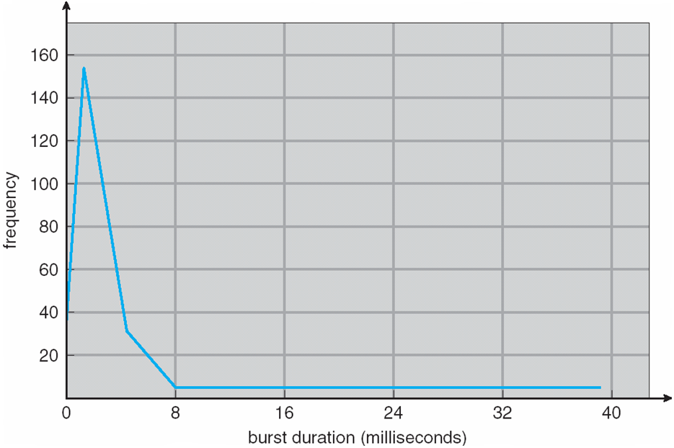
OPERATING SYSTEMS
Histogram of CPU-burst Times
The durations of CPU bursts have been measured extensively. Although they vary greatly from process to process and from computer to computer, they tend to have a frequency curve similar to that shown in the Figure.
An I/O-bound program typically has many short CPU bursts. A CPU-bound program might have a few long CPU bursts. This distribution can be important when implementing a CPU-scheduling algorithm.

Slide 8
OPERATING SYSTEMS
CPU Scheduler
Short-term scheduler selects from among the processes in ready queue, and allocates the CPU to one of them
Queue may be ordered in various ways
CPU scheduling decisions may take place when a process:
1. Switches from running to waiting state
2. Switches from running to ready state
3. Switches from waiting to ready
Terminates
Scheduling under 1 and 4 is nonpreemptive
All other scheduling is preemptive
Consider access to shared data
Consider preemption while in kernel mode
Consider interrupts occurring during crucial OS activities

Slide 9
OPERATING SYSTEMS
Preemptive vs Non-Preemptive Scheduling
Under non-preemptive scheduling, once the CPU has been allocated to a process, the process keeps the CPU until it releases it either by terminating or by switching to the waiting state.
Virtually all modern operating systems including Windows, macOS, Linux, and UNIX use pre-emptive scheduling algorithms.
Unfortunately, pre-emptive scheduling can result in race conditions when data are shared among several processes. Ex: While one process is updating the shared data, it is pre-empted so that the second process can run. The second process then tries to read the data, which are in an inconsistent state.
A pre-emptive kernel requires mechanisms such as mutex locks to prevent race conditions when accessing shared kernel data structures. Most modern operating systems are now fully pre-emptive when running in kernel mode.

Slide 10
OPERATING SYSTEMS
Dispatcher
Dispatcher module gives control of the CPU to the process selected by the short-term scheduler; this involves:
switching context
switching to user mode
jumping to the proper location in the user program to restart that program
Dispatch latency – time it takes for the dispatcher to stop one process and start another running

Slide 11
OPERATING SYSTEMS
Scheduling Criteria
CPU utilization – keep the CPU as busy as possible
Throughput – # of processes that complete their execution per time unit
Turnaround time – amount of time to execute a particular process (performance metric)
Waiting time – amount of time a process has been waiting in the ready queue
Response time – amount of time it takes from when a request was submitted until the first response is produced, not output (for time-sharing environment)
Notes:
Turnaround Time = Completion time – Arrival Time
Response Time = First run time – Arrival Time
Performance metric and Fairness metric are inversely related

Slide 12
OPERATING SYSTEMS
Scheduling Algorithm Optimization Criteria
Max CPU utilization
Max throughput
Min turnaround time
Min waiting time
Min response time

Slide 13
OPERATING SYSTEMS
First- Come, First-Served (FCFS) Scheduling
Process Burst Time
P₁ 24
P₂ 3
P₃ 3
Suppose that the processes arrive in the order: P₁ , P₂ , P₃ The Gantt Chart for the schedule is: Waiting time for P₁ = 0; P₂ = 24; P₃ = 27
Average waiting time: (0 + 24 + 27)/3 = 17

Slide 14
OPERATING SYSTEMS
FCFS Scheduling (Cont.)
Suppose that the processes arrive in the order: P₂ , P₃ , P₁ The Gantt Chart for the schedule is:
Waiting time for P₁ = 6; P₂ = 0; P₃ = 3
Average waiting time: (6 + 0 + 3)/3 = 3
Much better than previous case
Convoy effect - short process behind long process
Consider one CPU-bound and many I/O-bound processes

Slide 15
THANK YOU
Venkatesh Prasad
Department of Computer Science Engineering
venkateshprasad@pes.edu

